Slide 1
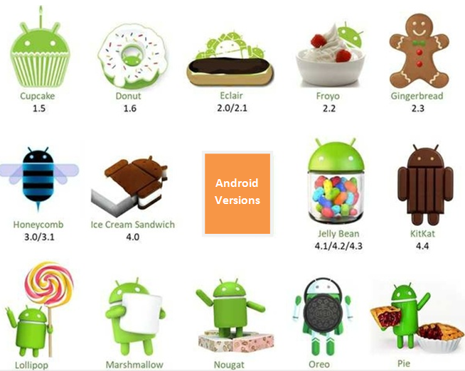
What is Android ???
Android is an operating system bought by google in 2005.
Originally developed by Andy Rubin, Rich Miner, Nick Sears, and Chris White at Android Inc.
It is based on Linux kernel.

Slide 2
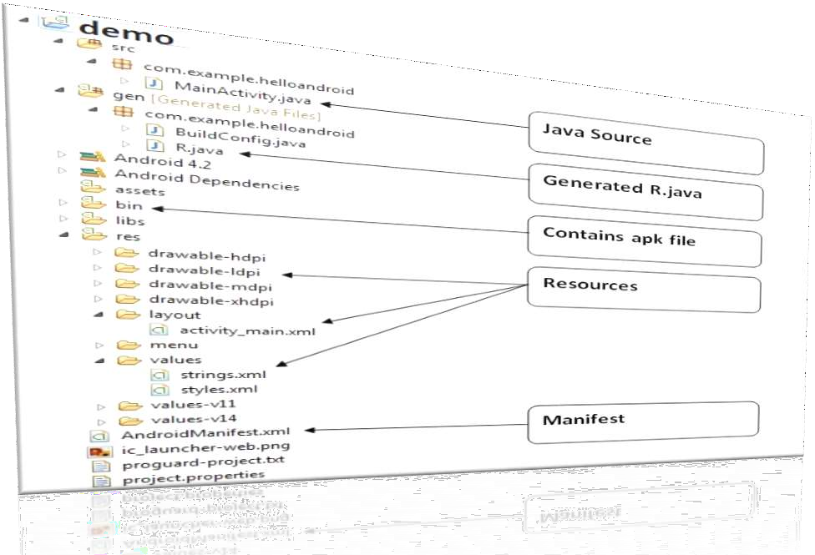
Android file structure

Slide 3
AndroidManifest.xml File
AndroidManifest.xml is the control file in every app.
Every service, ContentProvider, activity, Broadcast Receiver need to be mentioned in the AndroidManifest.xml file.
We will explore this file in details in our testing module.

Slide 4
Components of android app
Content Provider:
Content Provider component supplies data from one application to others on request.
Content Provider is helpful when an app want to share data with another app.
Activity:
An activity represents a single screen with a user interface.
It’s like every new screen is a activity.
One activity for login and another activity for login successful.
Services:
A service is a component that runs in the background.
A service might download some data while user is in a different application or play music while user is doing other activity.
Broadcast Receiver:
A broadcast receiver is a component that responds to system-wide broadcast announcements.
Apps can also send a broadcast message to other app know that some data has been downloaded to the device and is available for them to use.

Slide 5
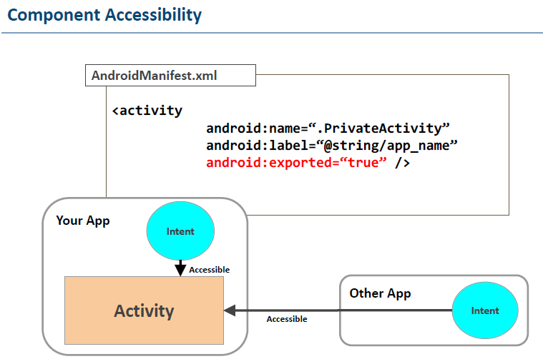
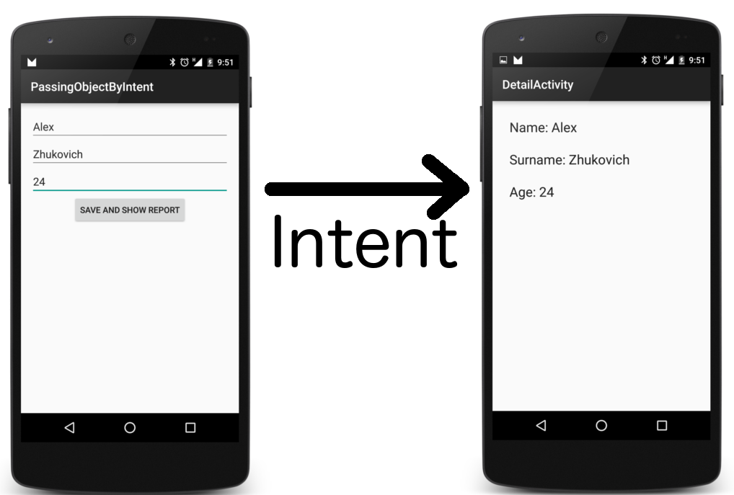

Slide 6
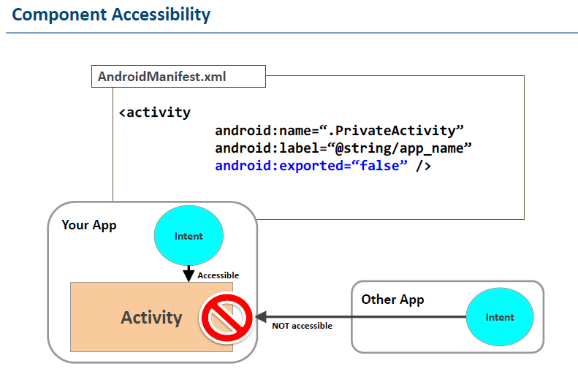

Slide 7
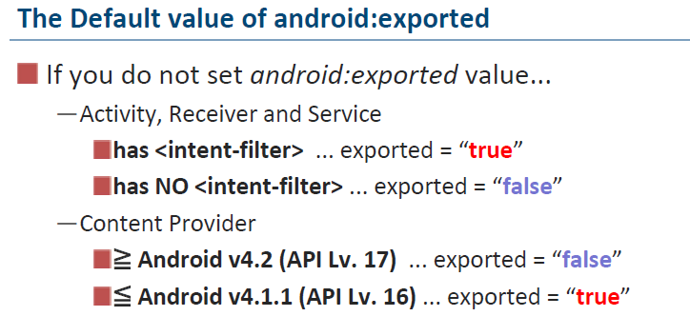

Slide 8
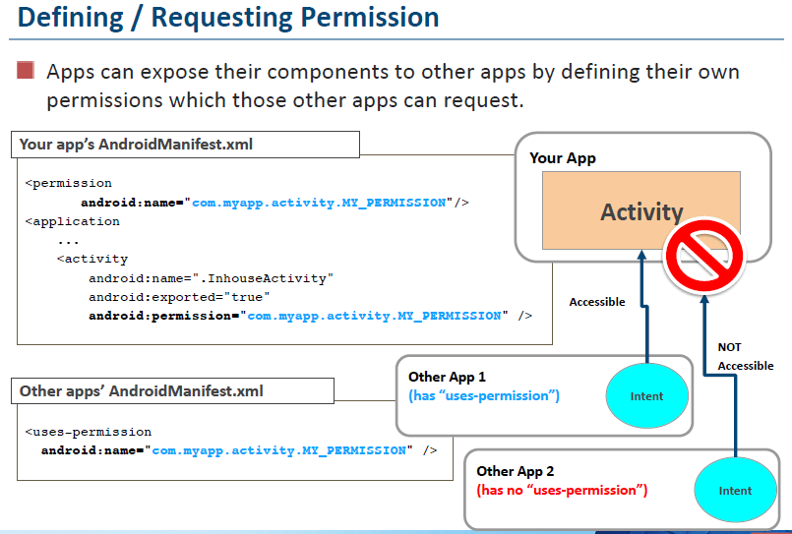

Slide 9
